Slide 1
Computational Materials Science
YALE PATHWAYS SUMMER WORKSHOP

Slide 2
LEARNING GOALS
How can we develop a mathematical model of a material?
How do very small particles behave differently than large particles?
Some examples of computational materials science discoveries

Slide 3
LEARNING GOALS
How can we develop a mathematical model of a material?
How do very small particles behave differently than large particles?
Some examples of computational materials science discoveries

Slide 4
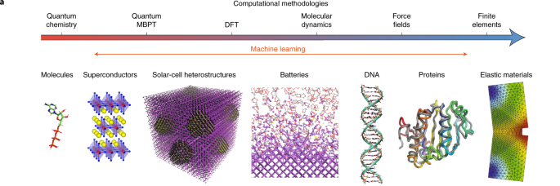
Computational Materials Science
High performance computing is used to study all kinds of materials systems

Slide 5
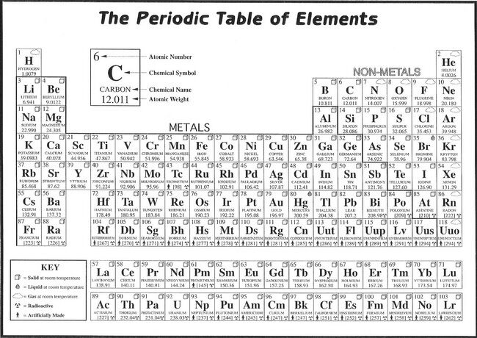
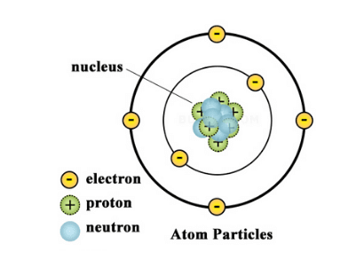
Computational Materials Science
We can model a material by splitting it up into small pieces and developing a mathematical equation the describes how those pieces interact with each other
One natural building block for such a model is to look at the atoms that make up the material
Atoms are composed of nuclei and electrons with difference elements containing different numbers of electrons
Every row represent a “shell” of an atom.
Atoms want to have 8 electrons in its outer shell.
The outer electrons are called valence electrons.

Slide 6
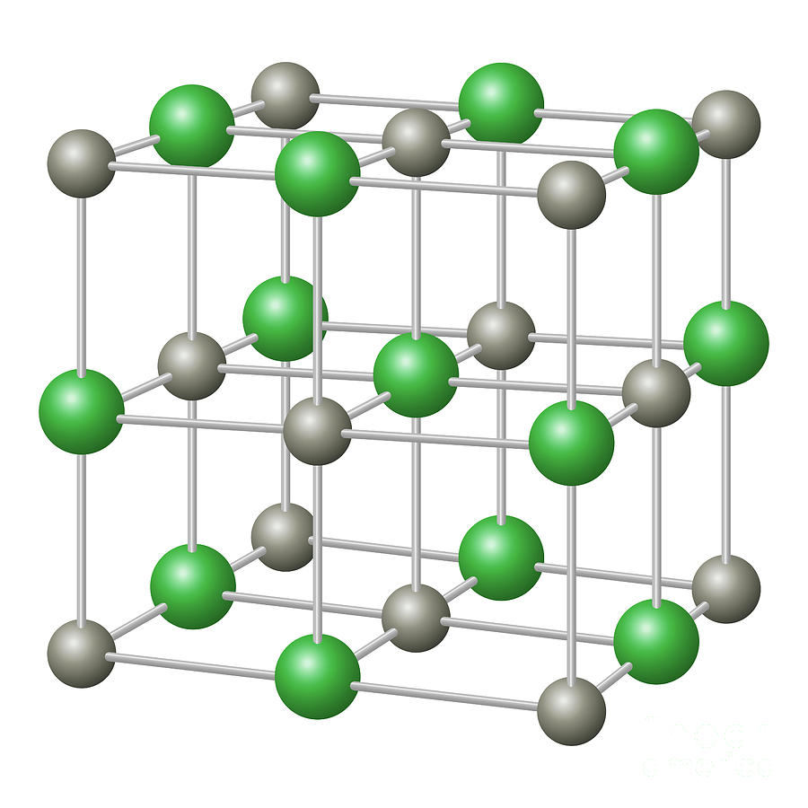
Computational Materials Science
Example 1: sodium chloride (table salt) is made up of a periodic array of sodium (Na) and chlorine (Cl) atoms
Every sodium atom has 1 valence electron
Each electron has a charge of -1e
Every chlorine atom has 7 valence electrons
Each electron has a charge of -1e
How is the sodium crystal held together?
Ionic bond between Na and Cl
Every atoms wants 8 electrons in its outer shell
Sodium loses one valence electron: Na -> Na⁺
Chlorine gains one valence electron: Cl -> Cl⁻
Positive and negative charges attract

Slide 7

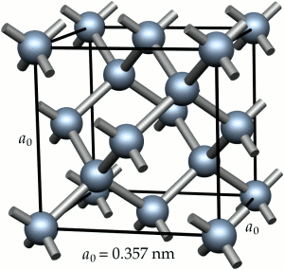
Computational Materials Science
Example 2: diamond crystal is made up of a periodic array of carbon (C) atoms
Every carbon atom has 4 valence electrons
Each electron has a charge of -1e
How is the diamond crystal held together?
Covalent bond between carbon atoms
Every atom wants to have 8 electrons in its outer shell
Every carbon atom shares each of its 4 valence electrons with another carbon atom
These shared electrons form a “bond” that between carbon atoms that holds the diamond together

Slide 8
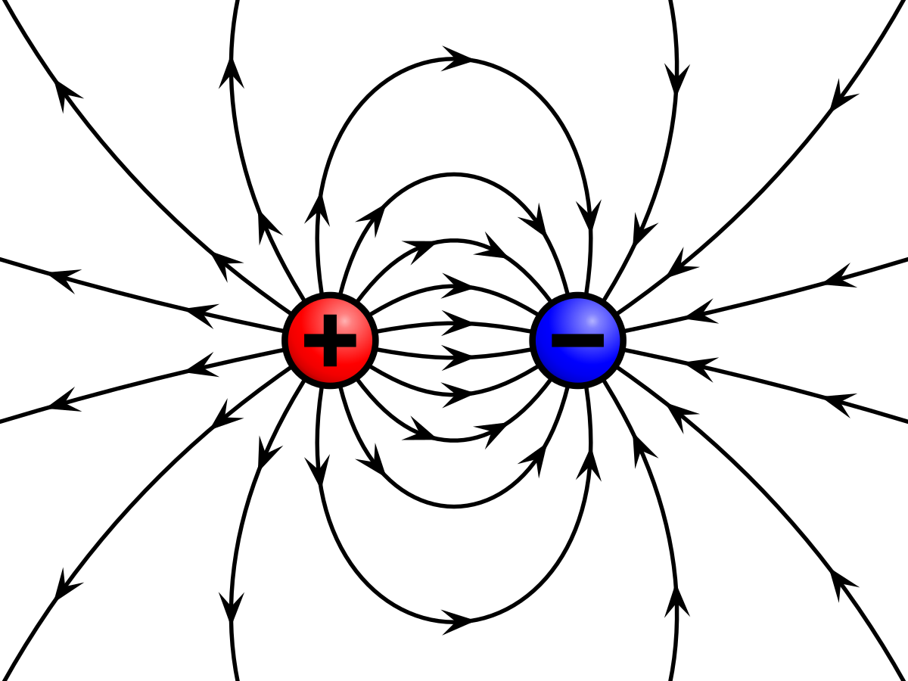
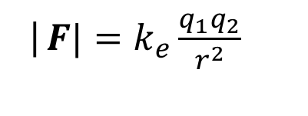
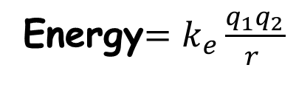
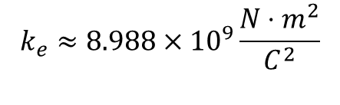
Computational Materials Science
q₁
q₂
Different bonding of NaCl and diamond requires chemical understanding
How can we model an arbitrary assortment of atoms and thus understand new materials?
The fundamental force that holds atoms together is the Coulomb interaction
Coulomb interaction:
Electric charges with opposite signs are attracted to one another
Electric charges with the same sign are repulsed by one another
The strength of the attraction/repulsion is stronger when the charges are close together
r
|$F|=k_{e}\frac{q_{1}q_{2}}{r^{2}}$
$$k_{e}≈8.988×{10}^{9}\frac{{N⋅m}^{2}}{C^{2}}$$
Energy$=k_{e}\frac{q_{1}q_{2}}{r^{ }}$

Slide 9
Computational Materials Science
Fundamental model for all materials:
Materials are made of atoms, which are made of electrons and nuclei
All electrons have charge –e
All nuclei have positive charge +Ne
We can model the forces or energies associated with a material by calculating the Coulomb interaction between all the electrons and nuclei and adding them up!
Example: Helium Atom: nucleus + 2 electrons
-e
r₁
Total Energy = $k_{e}\frac{\left(−e\right)\left(−e\right)}{{\left|r_{1}+r_{2}\right|}^{ }}+k_{e}\frac{\left(−e\right)\left(+2e\right)}{r_{1}^{ }}+k_{e}\frac{\left(−e\right)\left(+2e\right)}{r_{2}^{ }}$ + Kinetic Energy
+2e
r₂
Electron-electron interaction
Electron-nucleus interaction
Energy due to movement
-e

Slide 10
Computational Materials Science
If we know the total energy, then we can calculate the material’s structure because a collection of atoms will always want to go to its lowest energy (or ground state) structure
Workflow:
Place atoms in a box
Calculate total energy
Move atom positions slightly
Recalculate total energy
Does the total energy go up or down?
Keep moving atoms in the direction that minimizes the total energy.
The material structure has been found once the energy minimum is found.
Also related to material strength, bending, malleability, hardness etc.

Slide 11
LEARNING GOALS (Break)
How can we develop a mathematical model of a material?
How do very small particles behave differently than large particles?
Some examples of computational materials science discoveries

Slide 12
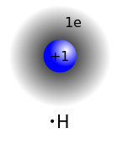
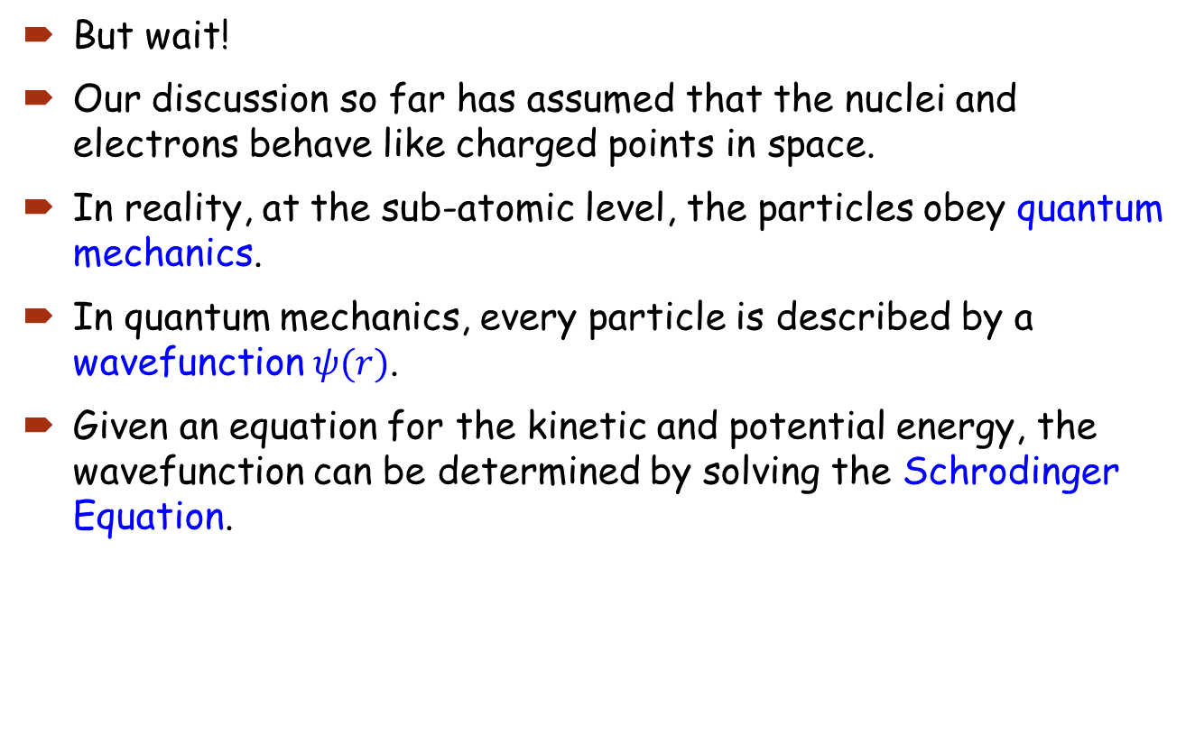
Computational Materials Science
But wait!
Our discussion so far has assumed that the nuclei and electrons behave like charged points in space.
In reality, at the sub-atomic level, the particles obey quantum mechanics.
In quantum mechanics, every particle is described by a wavefunction $ψ(r)$.
Given an equation for the kinetic and potential energy, the wavefunction can be determined by solving the Schrodinger Equation.
r

Slide 13
Computational Materials Science
So now we have a basic mathematical model that can be applied to any material:
Given an arbitrary arrangement of atoms, calculate the energy due to the interactions between all the charged electrons and nuclei
Solve the Schrodinger Equation to find the electron wavefunction, and thus, the probability of finding an electron in any particular location
Notice that we don’t need any experimental information! This is what’s known as a first principles or ab initio approach.
But wait! Materials contain a huge number of atoms!
Even with the world’s fastest supercomputer, the approach we describe above is impossible except for the smallest molecules.

Slide 14
Computational Materials Science
What to do?
We don’t necessarily care about the behavior of every individual electrons. We care about their average behavior.
Density functional theory (DFT)
Allows us to replace the behavior of all interactive electrons with 1 single electron in an average potential that approximates the interaction between
Developed by Pierre Hohenberg, Walter Kohn, and Lu Jeu Sham in 1964-1965
Walter Kohn wins Nobel Prize in 1998
DFT is the most widely used computational methods in materials chemistry and physics

Slide 15
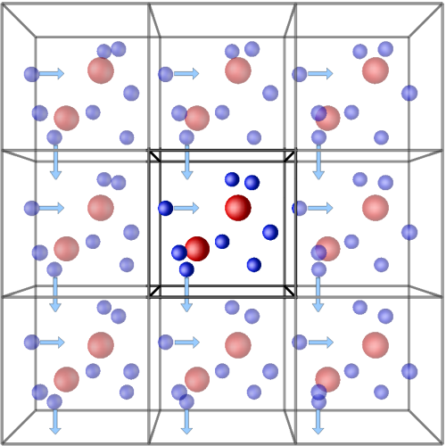
Computational Materials Science
Additional computational considerations:
Periodic boundary conditions
Crystals are formed from repeated units
In our simulation box, we can focus on a single unit and assume that the behavior of the material is perfectly repeated in all other unit cells
Pseudopotentials
The behavior of atoms in materials is mostly dictated by the outer shell of electrons
We only include outer shell electrons in our calculations
The nucleus + inner shell electrons are replaces by a “pseudo” nucleus with the same charge

Slide 16
LEARNING GOALS
How can we develop a mathematical model of a material?
How do very small particles behave differently than large particles?
Some examples of computational materials science discoveries

Slide 17

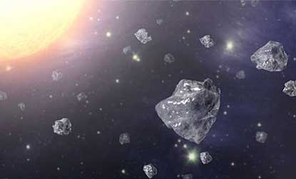
Example 1: Detonation Diamonds
When meteorites collide with the earth they create carbon nanoparticles with the same tetrahedral bonding arrangement as diamond – called diamondoids
Properties: biocompatible and extra hard
Can be used for drug delivery or as a nanolubricant
When a new material is discovered, the first question is, “what is its structure”?
Diamondoids: experiment sees unexplained features not seen in ordinary diamond
Simulation: DFT simulation of small nanoscale diamonds

Slide 18
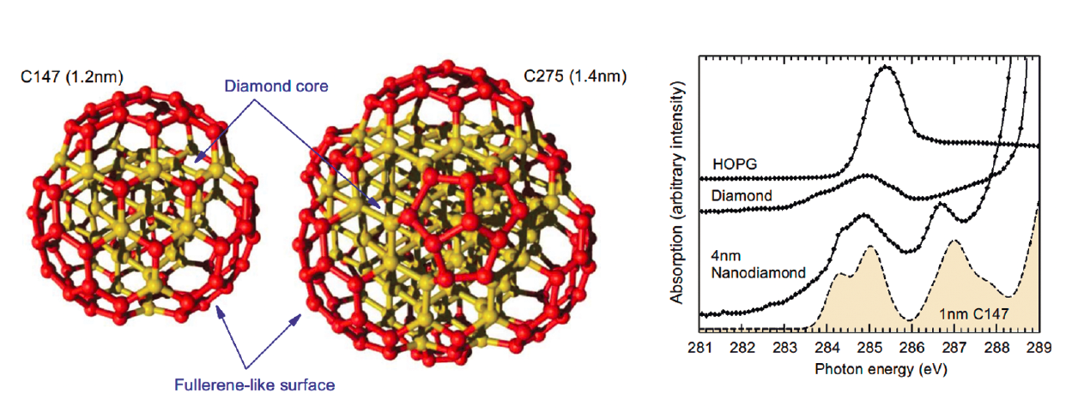
Example 1: Detonation Diamonds
Raty, J.Y. and Galli, G., “Ultradispersity of diamond at the Nanoscale,” Nature Materials (2003).,
Initial diamond structure evolves into diamond core with graphite-like fullerene shell. Reproduces experimental x-ray absorption spectrum.
Example of why DFT calculations are needed to unambiguously identify new materials
Notes:
HOPG=highly oriented polycrystalline graphite

Slide 19
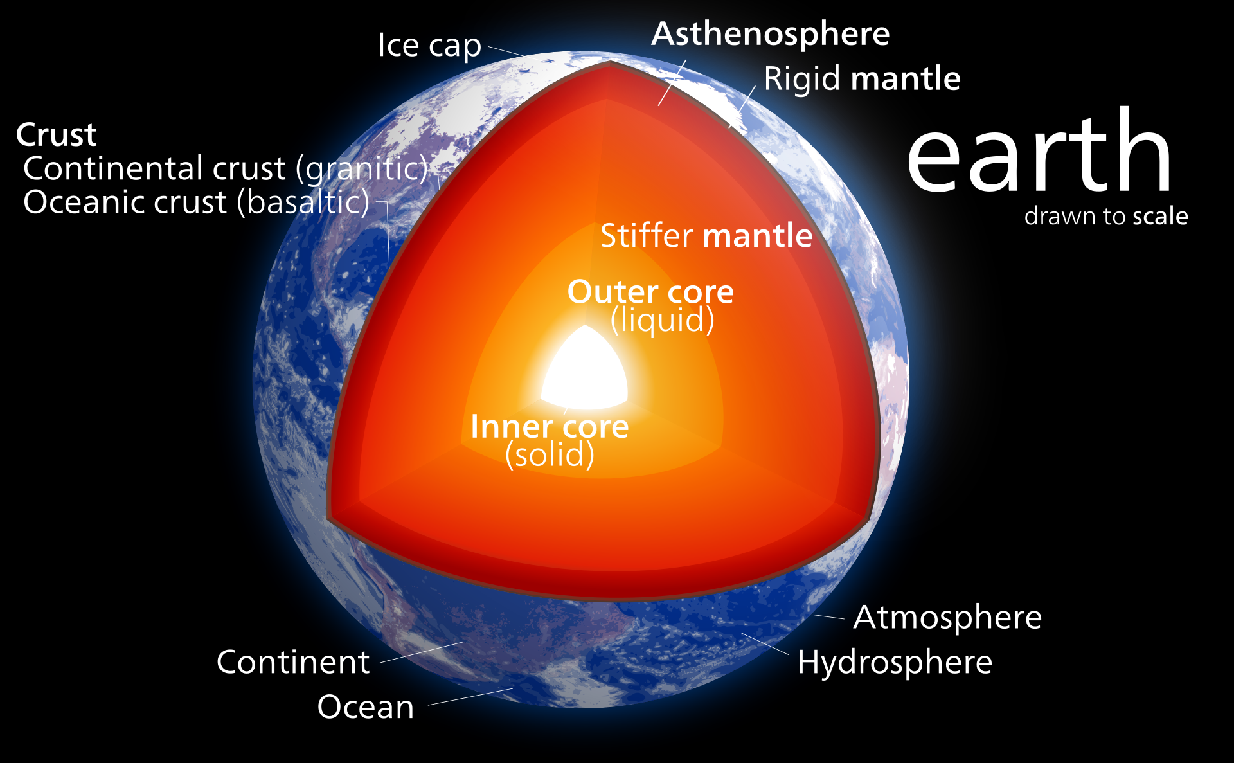
Example 2: Iron in the Earth's core
Some experiments are so challenging that different labs may produce significantly different results
One example is the temperature of the earth’s core
Direct measurement is not possible
Temperature must be inferred from the behavior of materials found in the core
Seismic data: core is mostly Fe, inner core is solid, outer core is liquid
Since solid and liquid coexist at the boundary, the temperature of the boundary must equal to the melting temperature of Fe at ~350 GPa
In labs, it is extremely hard to reach such high pressures to measure the melting temperature. Experimental uncertainty is about 2,000 K.

Slide 20
Example 2: Iron in the Earth's core
Computational approach:
Calculate energy of liquid and solid iron at different pressures
Change pressure by packing iron atoms closer together in simulation box
Find the point where the liquid and solid have the same energy
The temperature at this point is the temperature of the core
Temperature is about 10,000 degrees Fahrenheit
Alfe, Gillan and Price, “The melting temperature of Fe at the pressures of the earth’s core from ab initio calculations, Nature (1999).

Slide 21
Example 3: Discovering Better Catalysts
DFT can also be used to predict the properties of materials that have not yet been made
One important category of material are catalysts which make chemical reactions faster and easier
Splitting water into Hydrogen and Oxygen is an extremely important reaction for making hydrogen fuel
Pt is an excellent catalyst but very rare and expensive
One way of finding new catalysts is to perform a computational materials search
Aided by advances in high performance computing
Ongoing work, incorporating machine learning and artificial intelligence

